Slide 1

While loop in Python

Slide 2
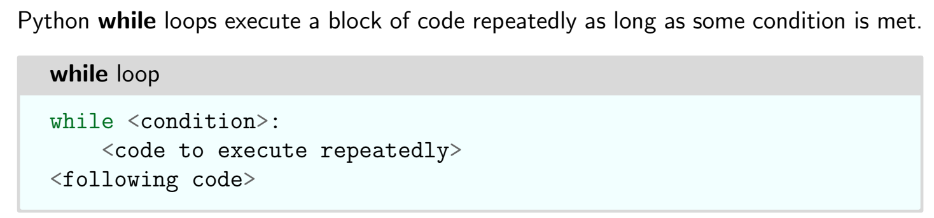
While loops

Slide 3
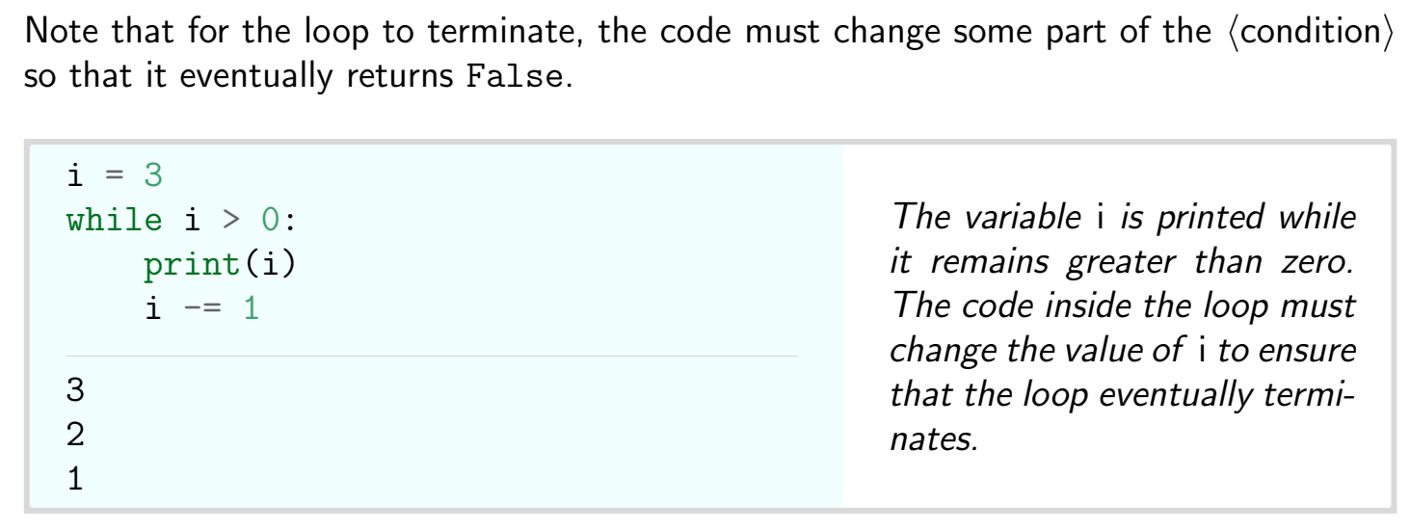
Example

Slide 4
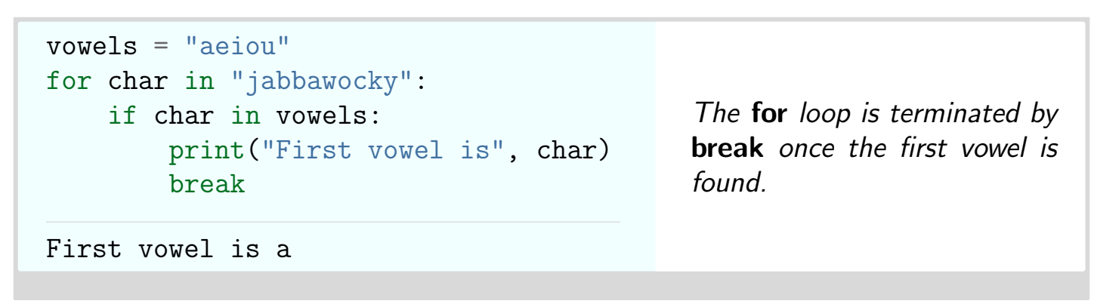
Break statement

Slide 5
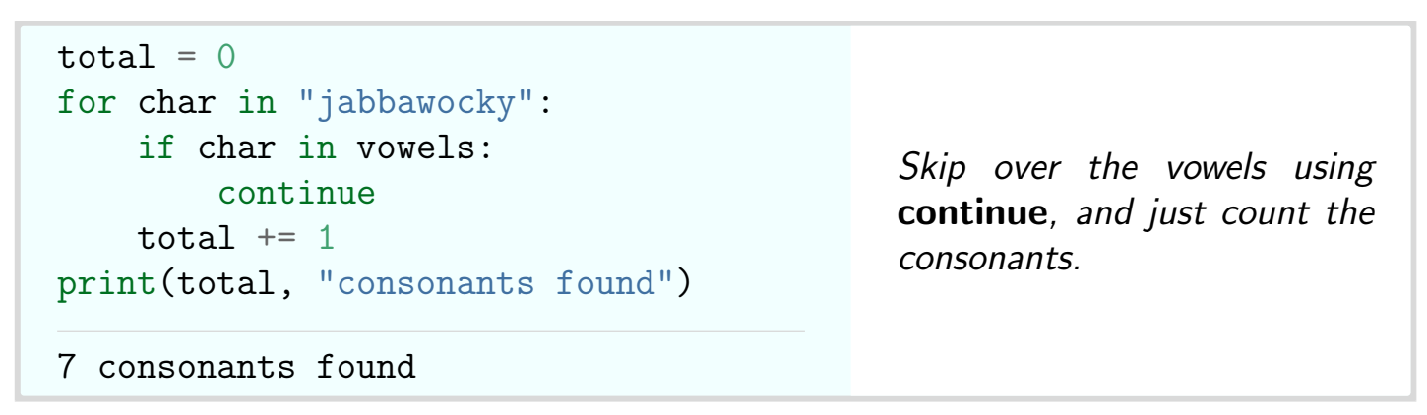
Continue statement

Slide 6
Thank You

